Slide 1
Welcome to advisory!
January 19 & 20

Slide 2
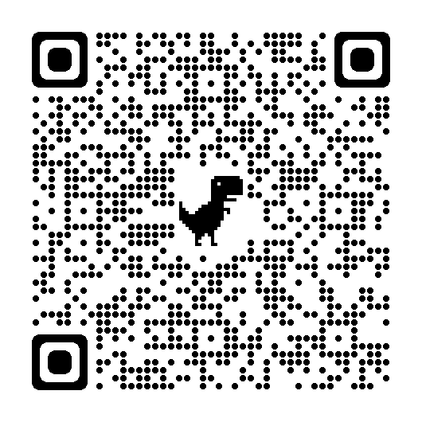
Nominate a peer for CLASSIES!!!

Slide 3
Mentor Skills day: informational interviews and networking
- What is the most difficult part of talking to someone you don’t already know?

Slide 4
Interview Skills
Question practice
Interview starters & stoppers
https://www.youtube.com/watch?v=OIMGPlH4XPo
https://soundcloud.com/kuow/radioactive-interview-example
Practice interviews using voice memo: “What’s a challenge or problem you’ve overcome and how did you overcome it?”
Reflection:
What questions worked well to get interesting answers?
What was challenging?
What other questions do you have about interviewing?
What would you do differently next time you did an interview?

Slide 5
Networking
Have an “elevator pitch” ready for networking events.
The concept of an elevator pitch is that it is a short but impactful speech in which you are trying to get something. It could be a job, an investment, advice, a longer meeting or anything else.
Resources:
https://youtu.be/Lb0Yz_5ZYzI
https://career.virginia.edu/ElevatorPitch

Slide 6
Student choice!
Either create questions for a potential mentor
Draft a pitch to get a mentor
Practice interview skills

