Slide 1
Welcome to advisory!
December 15 & 16

Slide 2
Gathering
What is something cute, funny or terrible you did as a child? What happened?

Slide 3
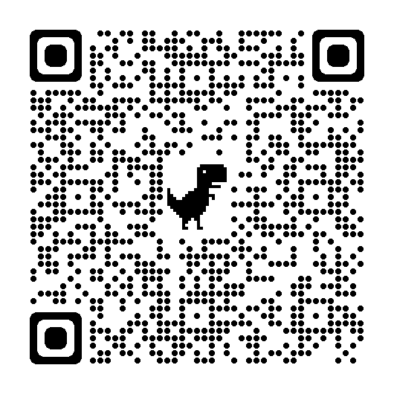
12/15
Survey for yearbook!
Aviation Theater Performance at 11:00am.

Slide 4
Special Announcement!
We have a squadron of F-18 flying in to Boeing field tomorrow and leaving Friday. The pilots are from the same squadron as RAHS alum Taylor Barret. They have offered a short tour and Q&A for some of our students on Thursday afternoon and Friday morning.
Please ask or select up two students and some standbys from your advisory if they’re interested in meeting Naval Aviators and learning about the job and the planes. The times for the event are
Thursday after school from 4:00pm-4:30pm
Friday before school from 8:00am-8:30am
We are still working out details but I think the opportunity is hard to pass up! Please send me your student names and I’ll compile a list for a short walking field-trip across the street. I’ll be in touch with the responders with details as they develop. Not for certain yet, but keep your fingers crossed!

Slide 5
12/16 Game!
Each person will get a small piece of paper.
Your job is to work together to figure out both the question and the answer to the question!
Let me know when you think you have it all figured out!

Slide 6
Game De-brief
Teacher led

