Slide 1
Quick Lesson(s)

Slide 2
What we’ll be covering
01
02
03
Parole
Police Misconduct
Your Rights
What is the process?
What does reentry look like?
The types of policing styles?
Types of Misconduct
Constitutional Rights
Limits to Police Power

Slide 3
01
Parole

Slide 4
Parole
Parole is releasing prisoners before completing a sentence
Still under the umbrella of the Criminal Justice System(CJS)
Supervised by a parole officer
NOT THE SAME AS PROBATION
Parole has a record, time spent in prison
Notes:
Supervision after being released

Slide 5
Types of Parole
Unconditional release (no parole)
No requirements post leaving incarceration (~1/5)
Discretionary parole
Parole granted by parole board’s discretion
Mandatory parole
Automatic parole set for a period of time, for almost all inmates
About ½ of states have this
Notes:
US Board of Parole created in 1930
About 800,00 people (increased)
Overrepresentation of men, and Black men
Unconditional release (no parole)
No requirements post leaving incarceration (~1/5)
Discretionary parole
Parole granted by parole board’s discretion
Mandatory parole
Automatic parole set for a period of time, for almost all inmates
About ½ of states have this

Slide 6
Board of Parole
Who makes up this board?
Only have a board with discretionary parole
A panel is made up of people appointed by a governor
These people grant or deny (deny majority of the time)
They have varying expertise
Is this equitable? Not really.

Slide 7
Factors Considered
Factors to decision making:
Rehabilitation
Ties to communities
Additional considerations:
- Nature of offense
- Criminal history
- Are they sorry?
- Mental health
- In-prison conduct reports
- Plans for parole
Notes:
- In a total institution
Are these ties severed when they’re incarcerated for so long?
- yes.
They have A LOT of power and discretion

Slide 8
Parole conditions
General conditions
Reporting
Employment
No new criminal violations
No firearms
Permission to change residence
These things can have waivers if not possible, example being if they are on disability and cannot work
Notes:
Additional conditions:
- Programs (alcohol programs, anger management, mental health programs)
No contact (Register as a sex offender for example)
Parole officers have the discretion to add conditions of needed

Slide 9
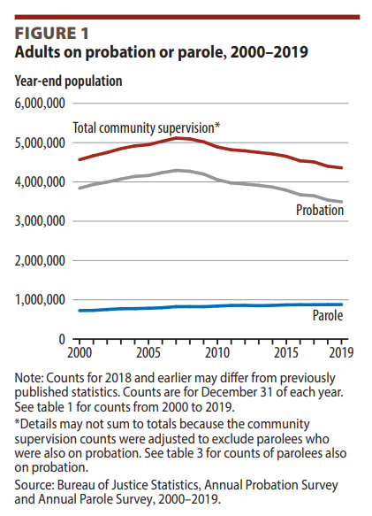

Slide 10
What does reentry look like?
Measuring parole success
Most want to succeed, most don’t.
What counts as success? (1/3)
A lack of recidivism
Crime and violation free
Do not return to prison
Supervision in the initial stage is key
Initial stage is the first 6 months to year
Notes:
Measuring parole success
Most want to succeed, most don’t.
This is the time people are most likely to reoffend
There is a subpopulation of people on parole who are reoffending
This subpopulation is about 16%, responsible for about ½ of all crime in this population

Slide 11
Reentry
Leaving prison and returning to society
Things that affect success:
Time in prison
Family support
Health
Housing
Employment
Notes:
Employment
Gives worth for some
Time spent not committing crime
Disconnects with negative social networks and connects with more positive ones
Strengthen relationships (safety net)
Those unemployed ¾ more likely to recidivate
Where are they going back to?
Recidivism likely if interacting with social networks
Lacking rehabilitation programs in prisons
Time in prison
More time in prison, less success

Slide 12
02
Police Misconduct

Slide 13
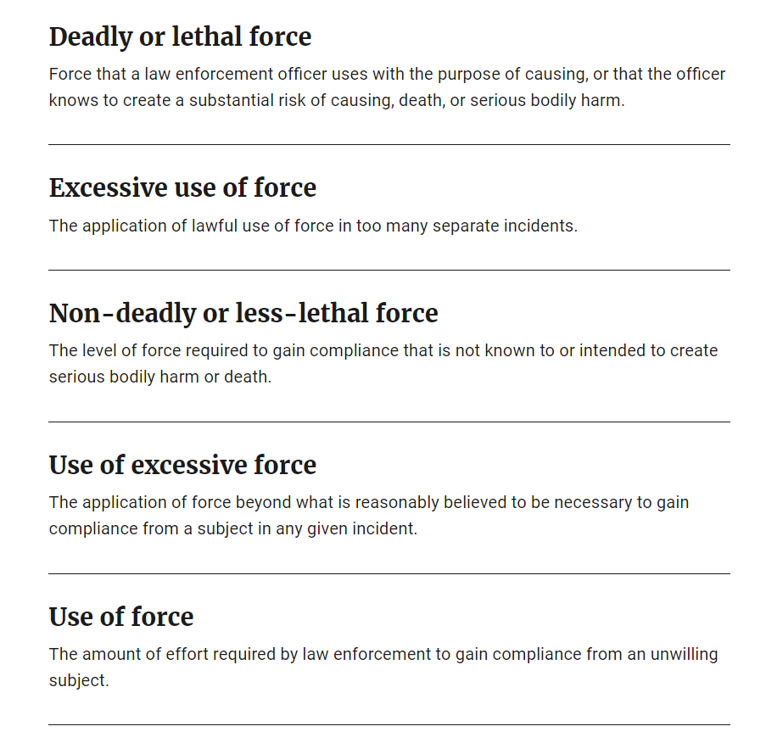
Bureau of Justice Statistics

Slide 14
Police are public servants
Ethics of public servant
Fairness – same treatment
Service – to protect and serve (public scrutiny)
Law- to protect and serve (bound by the constitution)
Personal conduct – held to a higher standard of behavior

Slide 15
Types of ethical decisions:
“Day to day ethics”
Gratuities
Substance use
discrimination
“Noble cause ethics”
Entrapment
Planting evidence
Use of force

Slide 16
How can we explain police misconduct?
Personality, predispositions
Authoritarian personality
Psychological orientation
Police occupational culture
Professionalism and group socialization

Slide 17
Styles Matter
Types of Policing Styles (Wordern 1995):
Department Styles
(Wilson 1968):
1.Tough Cop: noble cause ethics, not nice, prioritizes crime catching
2. Clean-beat crime fighters: procedural justice, NO VIOLATING LAW, relentless
3. Avoiders: do enough to get paid, don’t really care, low risk
4. Problem-solvers: less aggressive, less crime oriented, engaged with citizens
5.Professionals: more educated, favorable to citizens & supervisors, embracing all roles (department styles)
1. Legalistic – law enforcement
a. Urban/ more crime
2.Watchman- order maintenance
a. Rural/less crime
3. Service
a. Suburbs/ less crime

Slide 18
Police Use of Force:
Infrequent
Lower end of spectrum
Happens when making arrests
Incredibly consequential
Racialized

Slide 19
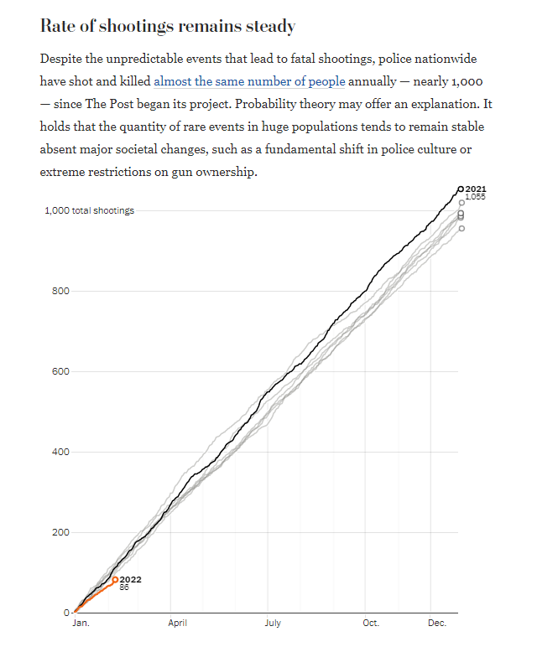
Washington Post

Slide 20
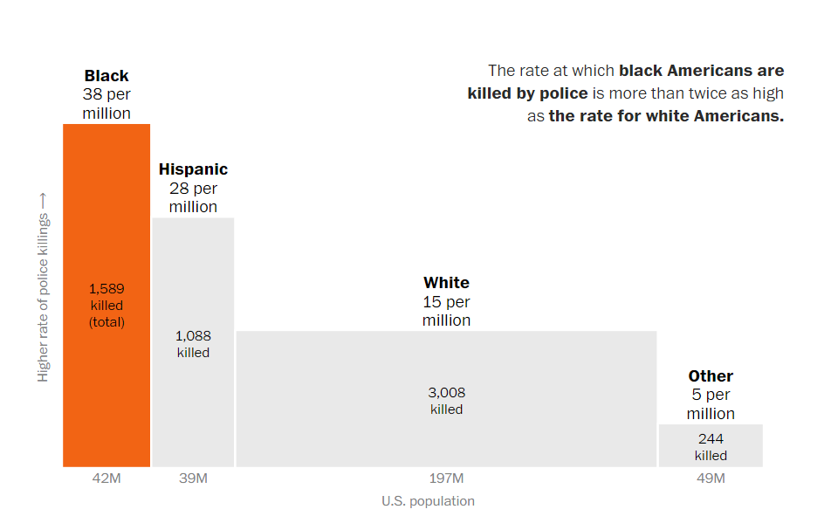
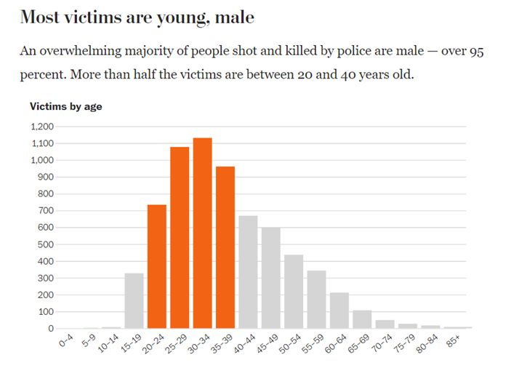
Washington Post

Slide 21
Laws

Slide 22
Washington State Legislature
Notes:
https://app.leg.wa.gov/RCW/default.aspx?cite=10.120.020#:~:text=%281%29%28a%29%20Except%20as%20otherwise%20provided%20under%20this%20section%2C,the%20person%20against%20whom%20force%20is%20being%20used.

Slide 23
King 5
Notes:
Consent decrees have been signed by a number of cities concerning their police departments' use-of-force policies and practices, including Chicago, New Orleans, Oakland, Los Angeles (whose consent decree was lifted in 2013), Ferguson, Missouri, Seattle, Portland, and Albuquerque.
Specific consent decree

Slide 24
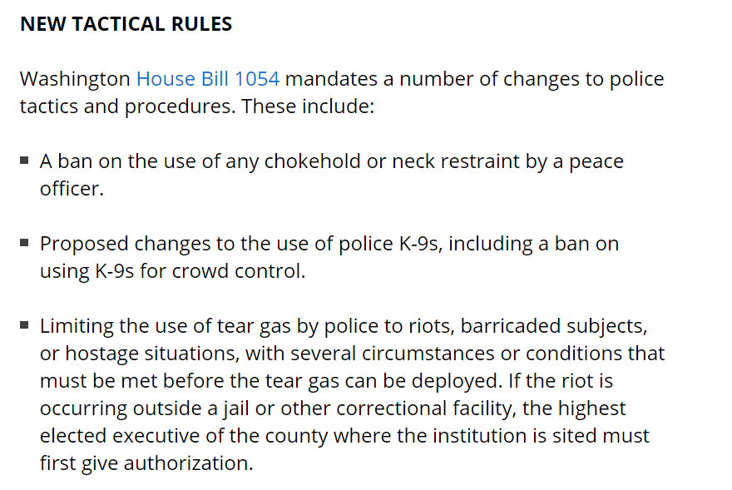
Police1
Notes:
https://www.seattle.gov/police-manual/title-8---use-of-force/8100---de-escalation
https://spdblotter.seattle.gov/wp-content/uploads/sites/11/2020/01/Dkt-605-1-SPDs-2019-Annual-UoF-Report.pdf#:~:text=Section%208.300%20addresses%20the%20use%20and%20deployment%20of,oleoresin%20capsicum%20%28OC%29%20spray%2C%20and%20vehicle-related%20force%20tactics.

Slide 25
03
Your Rights

Slide 26
Police have Power & Discretion
- Our Constitutional rights & Police limits to power
- 1st amendment: freedom of speech, religion, press, assembly
- 4th amendment: right to be free of unreasonable search and seizure
-8th amendment: cruel & unusual punishment
-14th &15th amendment: due process clause, no deprive of a person’s life, liberty, and property without due process of law

Slide 27
Limits to their power:
Miranda v. Arizona 1966
o Miranda warning
Mapp v Ohio 1961
o (Limits on how police obtain evidence)
Graham v Connor 1989
o Set the reasonable standard
Notes:
Miranda v Arizona
Miranda established that the police are required to inform arrested persons that they have the right to remain silent, that anything they say may be used against them, and that they have the right to an attorney. The case involved a claim by the plaintiff that the state of Arizona, by obtaining a confession from him without having informed him of his right to have a lawyer present, had violated his rights under the Fifth Amendment regarding self-incrimination.
In none of these cases was the defendant given a full and effective warning of his rights at the outset of the interrogation process. In all the cases, the questioning elicited oral admissions and, in three of them, signed statements that were admitted at trial.
Miranda v. Arizona: Miranda was arrested at his home and taken in custody to a police station where he was identified by the complaining witness. He was then interrogated by two police officers for two hours, which resulted in a signed, written confession. At trial, the oral and written confessions were presented to the jury. Miranda was found guilty of kidnapping and rape and was sentenced to 20-30 years imprisonment on each count. On appeal, the Supreme Court of Arizona held that Miranda’s constitutional rights were not violated in obtaining the confession.
Mapp v Ohio
The case began on 23 May 1957 when police officers entered the Cleveland home of Dollree Mapp looking for a person wanted for questioning in a recent bombing and seeking illegal gambling paraphernalia. After a thorough search, the police found neither the person nor the gambling materials. However, they did find obscene material, which Mapp denied owning. Possession of obscene materials was then illegal according to state law, and Mapp was arrested. In the fall of 1958, she was tried, convicted, and sentenced to 1-7 years in the penitentiary. No search warrant was produced at the trial, nor was the failure to produce one accounted for.
Graham v Connor
Graham v. Connor ruled on how police officers should approach investigatory stops and the use of force during an arrest. In the 1989 case, the Supreme Court ruled that excessive use of force claims must be evaluated under the "objectively reasonable" standard of the Fourth Amendment.
Graham, a diabetic man, rushed into a convenience store to buy orange juice to help counteract an insulin reaction. It only took him a few seconds to realize that the line was too long for him to wait. He abruptly left the store without purchasing anything and returned to his friend’s car. A local police officer, Connor, witnessed Graham entering and exiting the convenience store quickly and found the behavior odd.
Connor made an investigative stop, asking Graham and his friend to remain in the car until he could confirm their version of events. Other officers arrived on the scene as backup and handcuffed Graham. He was released after the officer confirmed that nothing had occurred within the convenience store, but significant time had passed and the backup officers had refused him treatment for his diabetic condition. Graham also sustained multiple injuries while handcuffed.

Slide 28
Dimensions that inform police behavior:
1. Individual
2. Structural
3. Legal

Slide 29
Your Rights
You have the right to remain silent.
o Remember- anything you say can and will be used against you in a court of law.
o Don’t lie
You have the right to refuse to consent to a search of you or your property
o Ask the officer if you are not under arrest. If you aren’t, you’re free to go, and if the officer says yes, leave.
If you are arrested, you also have the right to a lawyer.
o Do not say anything or sign anything without a lawyer.
o Do not resist arrest.
o Be polite, don’t panic
o Remember- You have constitutional rights.
Notes:
Won’t read you your rights until you’re booked

Slide 30
Questions

