Slide 1
Advancing Equity Through Family Engagement
Lolita O’Donnell l Student Support & Family Engagement

Slide 2
Session Agreements
Stay Engaged
Speak Your Truth
Experience Discomfort
Expect and Accept Non-Closure
Listen to Understand
Take Responsibility for Self
Adapted from Glenn E. Singleton & Curtis Linton, Courageous Conversations about Race

Slide 3
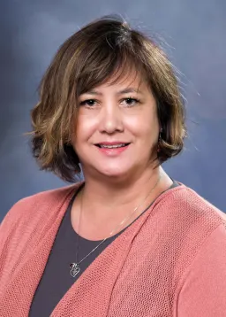
About Me
I live in the Highline Community and a proud mom of two HPS graduates. I have been a playground monitor, paraeducator, secretary for language learning, student placement and district ombudsman. Currently I am the Director of Family and Community Partnerships. In my role I am responsible to develop, plan, lead and direct district-level strategies and staff in the areas of family engagement and community partnerships. I also oversee translations and interpretations, truancy and the Family Center.
lolita.odonnell@highlineschools.org

Slide 4
Every Student At the Center
We will foster strong partnerships with families and community that extend beyond the school day.
We will provide professional learning that includes strategies to engage families around student learning and social, emotional and academic progress.
We will know our students by name, strength and need and have open, two-way communication with students, families and community partners.
We will implement schoolwide agreements and strategies that support a positive learning community built on the knowledge of students and families providing opportunities to restore relationships and repair harm

Slide 5
Advancing Equity Through Family Engagement
Effective Family Engagement is a strategy to promote racial equity. 81.9% of our student in HPS are students of color; in contrast, HPS staff is 73.8% White. It is essential if we come from a racial, ethnic, socioeconomic, or religious background different from our families to interrogate our own implicit biases.

Slide 6
Think about a Successful Partnership
Why was it successful?
What did you enjoy about it?
How did you collaborate, and why did you complement each other?

Slide 7
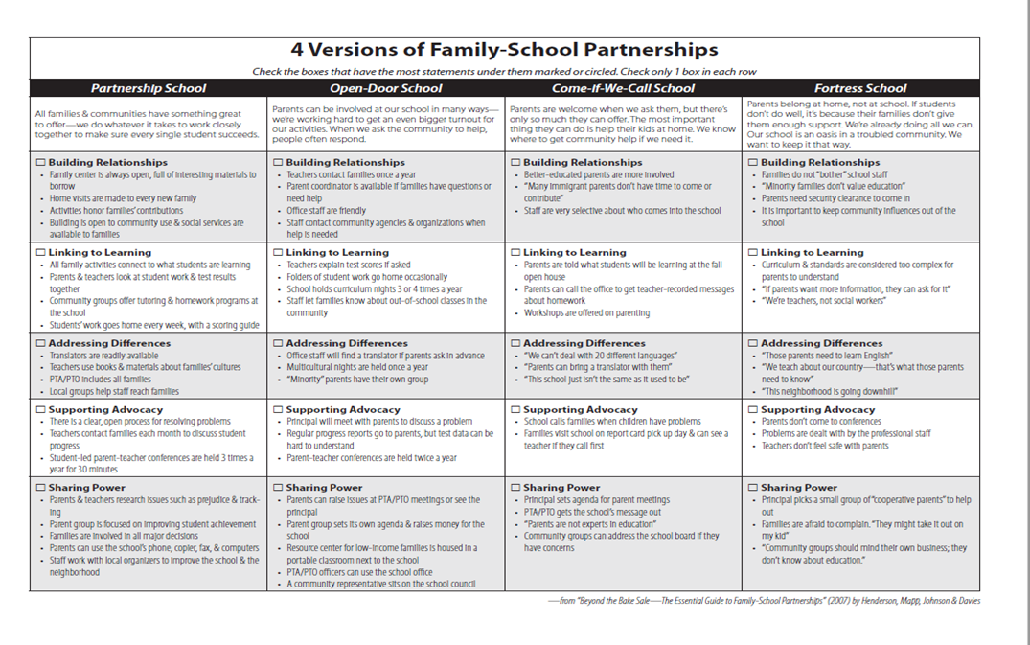

Slide 8
Partnership Rubric
Directions

Slide 10
Fortress School (Below Basic)
At a Fortress School, engaging with families is low priority and isn’t thought of as being connected to student outcomes. The standard events for families are held each year mostly out of compliance. Staff have experienced very low turnout at most events and, as a result, are discouraged and not enthusiastic about family engagement.
What you might hear or experience ….
Parents don’t care about their child’s education
Information about curriculum, standards, and learning goals is way too advanced for the parents at our school. Some don’t speak English, some never graduated from high school. We don’t want to overwhelm them with information that they just won’t understand”

Slide 11
Come-If-We-Call-School (Basic)
Come-If-We-Call Schools are more positive about the concept of engaging families, but the school sets the terms of engagement. Most of the communication is one way- from the school home, and families can come to school only when invited. These schools operate with a “don’t call us, we’ll call you” culture.
What you might hear or experience ...
All contact with teachers and school leaders must go through the front office staff; teachers never share their contact information with families.
Workshops for families are planned by school staff without parent input or feedback. Families are invited to open house or back-to-school night to hear the school and classroom rules and regulations.

Slide 12
Open-Door School (Proficient)
Open-Door Schools make family engagement a priority and see it as an important part of student success. More targeted efforts are made to reach out to invite families to be engaged with a focus on helping families to support their children’s learning.
What you might hear or experience ...
Family engagement is coordinated by a committee or an “Action Team” that includes families and school staff. The school holds various events for families, such as literacy nights, math nights, or science fairs, three or four times a year.
Family diversity is recognized through multicultural events and translation is provided at these and other events held at the school.

Slide 13
Partnership School (Advanced)
At a Partnership School, family engagement isn’t done out of compliance or because of mandates. Engaging with families is seen as a commitment and a key component of the school’s functioning. Families are seen as true partners in the teaching process and are valued as knowledgeable and important contributors to the school and school improvement.
What you might hear or experience ...
Families are regarded as full partners with the school staff in improving educational outcomes. All family events and initiatives are connected to student learning and development.
Staff are intentional about developing relationships of trust and respect with all families and engage in relationship building practices such as home-visits.

Slide 14
If three or more of your checked boxes fall in the Fortress School section and none fall under Open-Door or Partnership, your school is trying to keep parents away rather than work with them.
If three or more of your checked boxes fall under Come-If-We-Call and none are under Partnership, your school may want parents to be involved only on its terms.
If at least four of your checked boxes fall under Open-Door or Partnership and none are under Fortress School, your school welcomes families and supports them to be involved in a number of ways.
If at least three of your checked boxes are under Partnership and the rest are under Open-Door, your school is willing and able to work with all families.

Slide 15
Strong Partnerships May Start at any one of these Four Levels

Slide 16
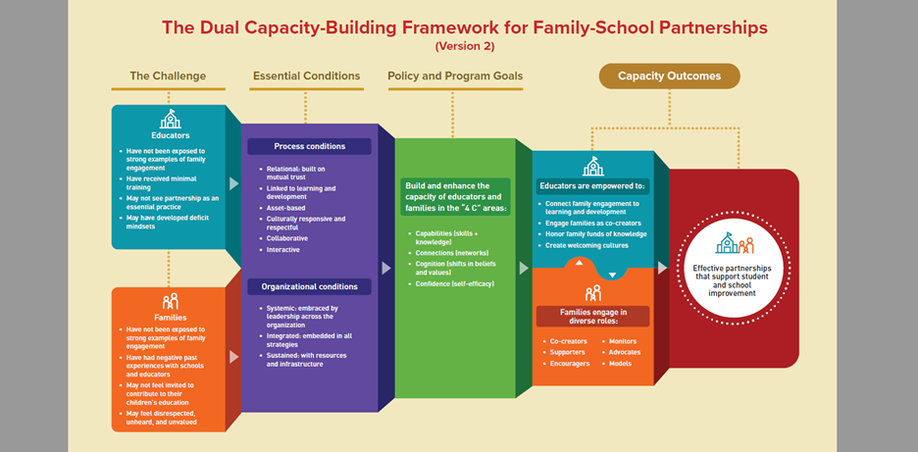
Dual Capacity Framework
Notes:
Link to the Dual Capacity Website https://www.dualcapacity.org/
View Dr. Mapp describes the Framework in Depth video

Slide 17
Essential Conditions | Example (s) of personal success with each process condition If you are unsure, you may jot an example that someone shares | How could I (better) achieve this? Think about Principles of Adult Learning. Then use these to think of actionable ways you could be more successful. | Which school or district stakeholders (if any) could I ask for support from in order to be more successful? You can’t do everything alone!
Relational: Do families and school staff have an opportunity to learn about each other, to share stories, and to build partnerships that are based on respect?

Slide 18
Relational
Efforts must be intentional about building relationships of trust and respect with families
Opportunities to learn about each other, share stories, build partnerships that are based on respect.

Slide 19
Linked to Learning
Aligned with the learning and developmental goals for the students.
Opportunity for families to learn and master a new skill in support of a particular learning goal.
Families know more about what their children should know and be able to do.

Slide 20
Asset-Based
Families have strengths and knowledge on which you can build.
Families knowledge and skills can help us develop and grow as educators.

Slide 21
Culturally Responsive and Respectful
Awareness and understanding of cultural differences based on race, ethnicity, nationality, language, and other forms of identity, while also valuing, honoring, and affirming those diverse cultural perspectives and backgrounds.

Slide 22
Collaborative
Initiatives bring families and staff together so they can learn from each other.
Everyone is viewed through an asset-based lens - teachers, families, community members, students.

Slide 23
Interactive
Principles of Adult Learning
Adults want to learn (helping their children is a strong motivator)
Adults learn only what they feel they need to learn
Adults learn by doing
Adult learning focuses on problems, and the problems must be realistic
Experience affects adult learning
Adults learn best in informal situations
Adults want guidance

Slide 24
Essential Conditions
Think of examples of a personal success with each of the process conditions
Think about actionable ways you could be more successful
Who at your school could you ask for support from in order to be more successful?

Slide 25
Reflections
One connection I have Is:
One statement that surprised me was:
Something I heard that I would like to keep in mind moving forward is:
One idea someone shared that I would like to commit to trying is:
Partnership Clip: Listen to educators reflect on their experiences with family engagement
Notes:
https://www.scholastic.com/pro/PartnershipsResources.html
Password effective

Slide 26
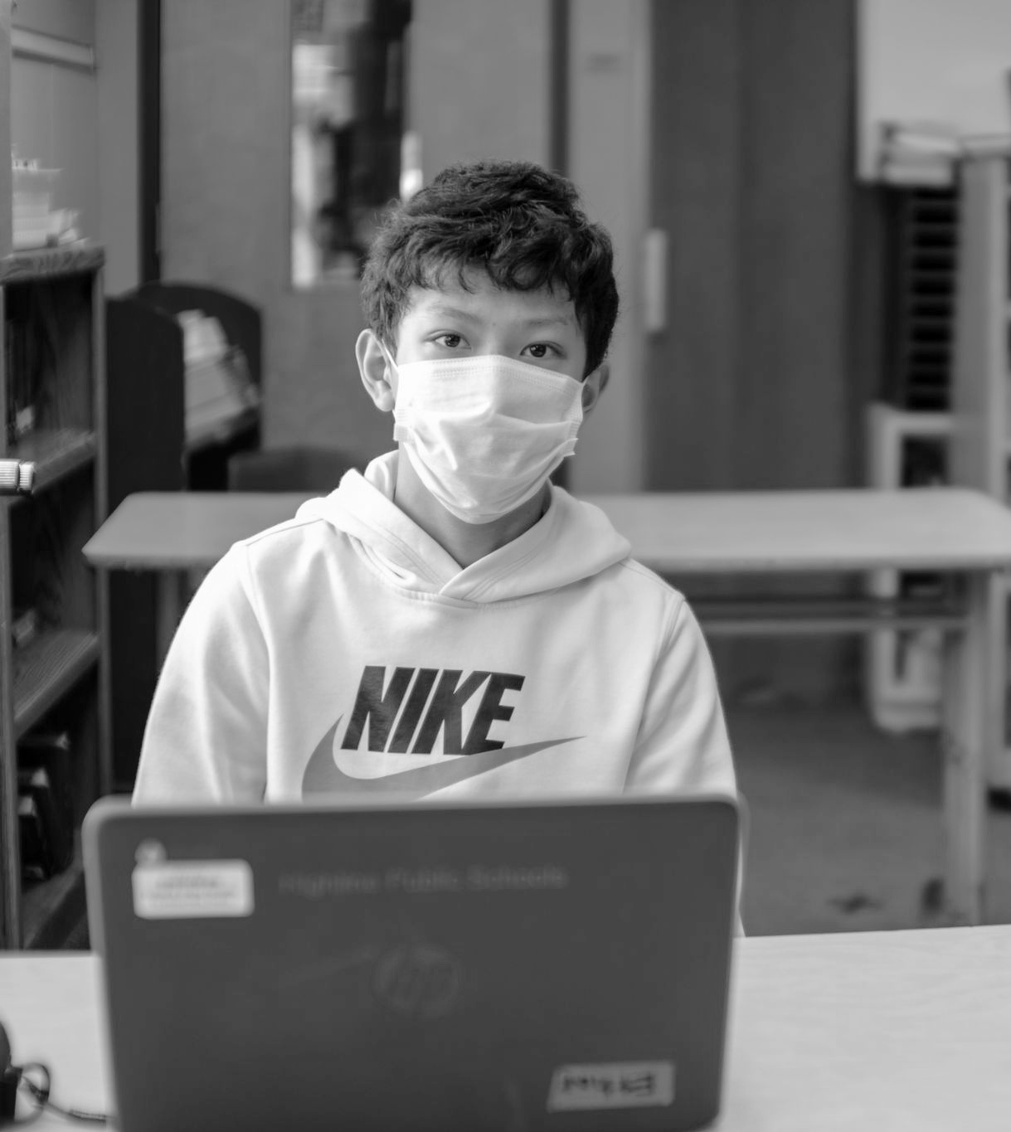
Acknowledgements
This presentation is based on “Powerful Partnerships; A Teacher’s Guide to Engaging Families for Student Success” by Dr. Karen Mapp, Ilene Carver, and Jessica Lander

Slide 27
“Where you are is where you start and where you start is a good place … because you are starting”
— Michele Brooks - former Assistant Superintendent for Family and Student Engagement in Boston Public Schools and Educational Consultant for Transformative Solutions

Slide 28
Give Feedback
We want to hear your input. Please complete our online feedback form for today’s session.
staff.highlineschools.org/feedback

Slide 29
Questions?
Lolita O’Donnell l Director of Family and Community Partnerships l Student Support and Family Engagement
Lolita.ODonnell@highlineschools.org
206.631.3151

